Slide 1
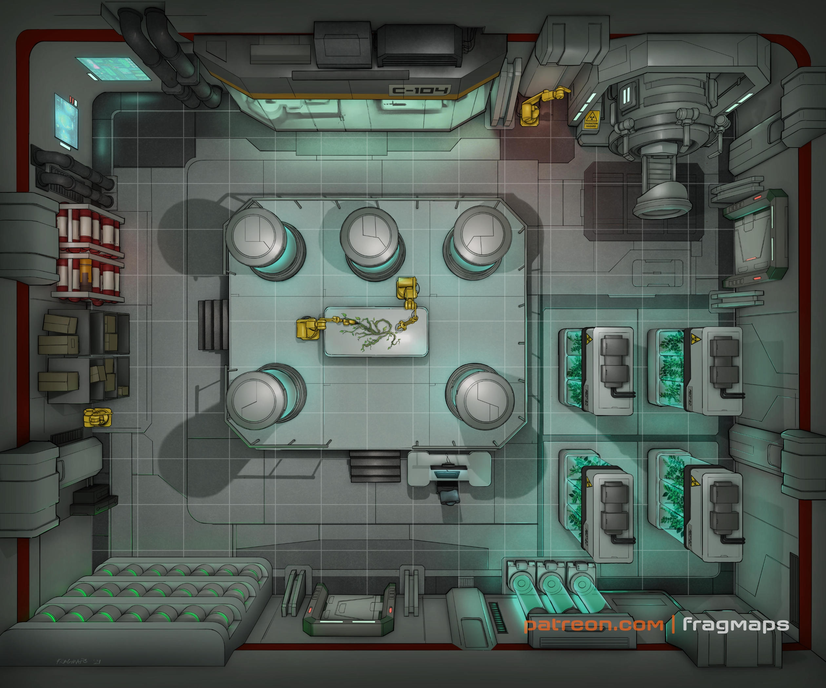
The Plot: A small corp is being bought out by Saeder-Krupp over an HMHVV IA strain. The Job: Infiltrate the corp, steal the samples, and destroy everything else. The Pay: 500¥ up front, 1000¥ for the sample, bonus for destruction.
Scene 1 (Social). Setting: Dante's Inferno, Downtown. The Hook: Runners were told by their fixers to meet here. Given dossiers with images, major skills, names of the rest of the team (have players introduce their characters). Events: Influence + CHA (3) – Bartender directs the player to a back room where Mr. Johnson awaits. Negotiation: per SMG p16, vs Influence 5 CHA 6, 5% increase/decrease in base pay per hit (max still 3k per SMG).
Scene 2 (Investigation). Setting: per players. Available Info:
Crucible was a corporate non-entity. Maybe a dozen researchers and staff that made custom reagents as testing supplies for specialized laboratories. Overnight they were upgraded to A rating and are now the subject of a bidding war.
Four weeks ago they brought on a new hire, Dr Vijay Kaki. Vijay has very little published research himself, but was an assistant lab tech during the Boston Lockdown.
There are no pictures of Vijay after the Lockdown taken in daylight.
HMHVV IA is the Bruckner-Langer strain, isolated in 2046 and believed to result in Nosferatu and maybe mutaqua.
Crucible itself has no physical presence, but a holding corp has a warehouse in Puyallup.
Scene 3 (Investigation). Setting: Island 37. Edge: 1 per 2 successes in Scene 2 for each player (max 2). Challenges:
The warehouse is in a "nicer" part of Puyallup. Security is Rating C (CRB 239) in the surrounding area.
The warehouse has been converted into a makeshift lab. All the windows have been sealed and blacked out. Air recirculators and UV lamps prevent metahumans from entering in mist form, microdrones, etc.
Magical security was recently buffed as the bidding war got serious. Now rating 3 watcher spirits.
Matrix security has been recently improved. The lab's host (rating 5) is now airgapped from the Matrix. (It has control of interior security cameras as well as the lab's research data and equipment. There is no onsite spider but a host of aggressive IC have been loaded.)
The two lab entrances have airlocked doors and decontamination zones. The exterior doors have mechanical locks (rating 5), while the interior doors are maglocked and controlled by the lab host.
A high number of Knight Errant patrol near the lab. Not enough to give the lab away, but as often as plausible in Puyallup. Initial High Threat Response will occur in 30-60 seconds if triggered.
Once the PCs get in, the samples are in one of the incubators in the lower right (PG-13+: these are axolotl tanks containing embryos infected with HMHVV IA, which is how Crucible stabilized the strain). Biotech (Medicine) + LOG (7, 1 minute) to find the right tank.
The host, other samples, lab equipment, and records can all be destroyed for bonus pay.
Optional Rules for Initiative. Purpose: Get all players involved in all scenes at First Taste. Social: Influence + CHA. # hits determines order. Ties: Edge, CHA, INT, Coin Flip. Investigation: Perception + INT. # hits determines order. Ties: Edge, INT, REA, Coin Flip.
Inferno
A Shadowrun 6e First Taste by Zeshan Rajput
https://creativecommons.org/licenses/by-sa/3.0/
CRB: Shadowrun 6th Edition Core Rule Book
SMG: Shadowrun Missions Guide v1.6
Map Credit: Fragmaps on Patreon
Scene 4 (Combat). Setting: The laboratory once HTR is triggered. Edge: 1 per player if they get advanced notice, 1 more (max 2) if they set up an ambush. Challenges: 1 enemy per player (max 4). Choose from:
Patrolman (CRB 206),
Decker (CRB 205),
Combat Mage (CRB 206),
SWAT Officer (CRB 206).
A new HTR team will be sent if the first does not report back in one minute. If the second doesn’t respond, HTR will be escalated to higher levels.
Picking Up the Pieces. Pay: negotiated pay plus bonus for destruction. Max 3k per player. Karma: 3 karma for adventure survival. Contacts: None.

